Slide 1
BIU DATA SCIENCE · MIDTERM PROJECT
Teaching a Machine
When to Trade
the gap
Pairs trading + machine learning — a model that picks the winning signals.
200
4,988
+9.2 pts
stocks scanned
signals analyzed
win-rate improvement
Netanel Farhi · Idan Gilad — Bar-Ilan University · DS23 · July 2026
Notes:
0:30 — Hook: we taught a computer to be a picky trader. Introduce yourselves. Promise: by the end, these three numbers will make sense.

Slide 2
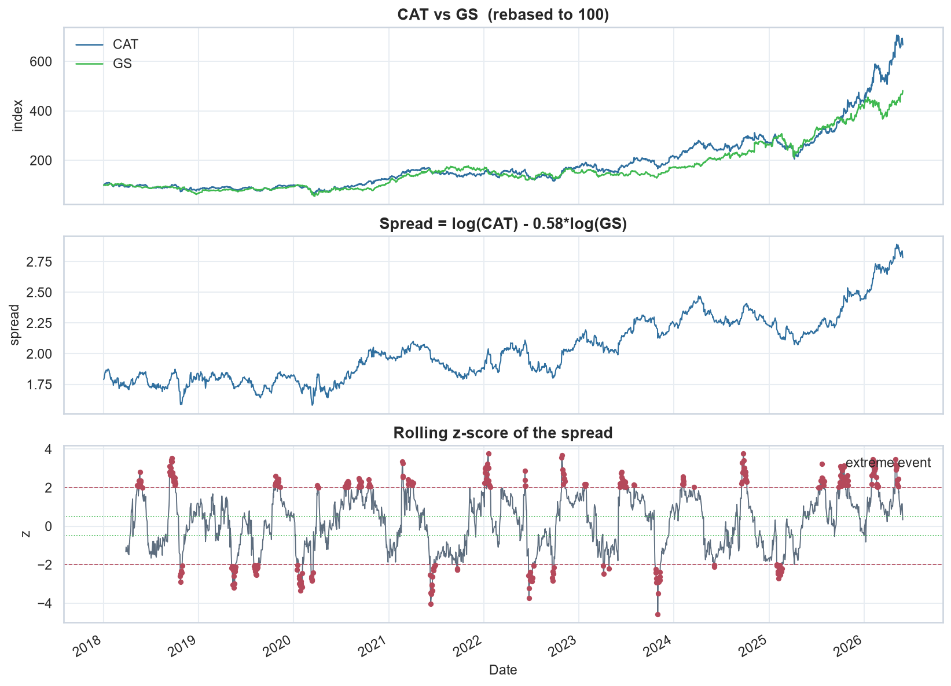
PRESENTER: NETANEL FARHI
01 · PAIRS TRADING — SIMPLE EXPLANATION
The game: two stocks, one gap
Two similar companies
Their prices move together for years.
The gap stretches
One drifts unusually far from the other.
Trade the snap-back
Buy the cheaper, sell the pricier — win if the gap closes within 10 trading days.
The real thing — CAT vs GS. Red dots = stretched moments.
2 / 13
Notes:
1:30 — Teach the game before anything else. Rubber band metaphor. Point at the top panel (they move together), then one red dot (stretched), trace the snap-back. No jargon yet.

Slide 3
PRESENTER: NETANEL FARHI
02 · BUSINESS PROBLEM & OBJECTIVE
The catch — and our fix
Most stretched gaps do not
close in time.
Our fix: predict at signal time whether the trade will succeed — take only the good ones.
~1 in 5
signals ends in success if you
trade all of them
every signal
worth trading
The model's only job: veto the bad ones.
3 / 13
Notes:
1:15 — Left: the business problem — trade everything and ~4 of 5 bets lose. Right: our fix in one sentence — a model that vetoes bad signals. Many grey dots in, few green out. || Gilad, verbatim: Statistical-arbitrage pairs trading relies on price spreads mean-reverting, though structural breaks pose the main risk. We use Pearson correlation and cointegration to select pairs; the question — will an extreme spread revert? — is handled by the supervised learning model. The unit of observation is an extreme event based on the z-score and horizon; our dataset is built from these events.

Slide 4
PRESENTER: NETANEL FARHI
03 · METHODOLOGY & WORKFLOW
How does it work?
Find pairs
Detect signals
Describe each signal
Predict success
1
2
3
4
statistical proof they
move together
the gap stretches
past normal
29 measurements
probability the gap
closes in time
Signal rule: enter when |z| ≥ 2 · success if back to |z| ≤ 0.5 within 10 trading days
4 / 13
Notes:
1:00 — Walk the four steps in plain words. The chip is the only formula in the talk — z just measures how stretched the gap is. Gilad’s timing rules get their own slide in a moment.

Slide 5
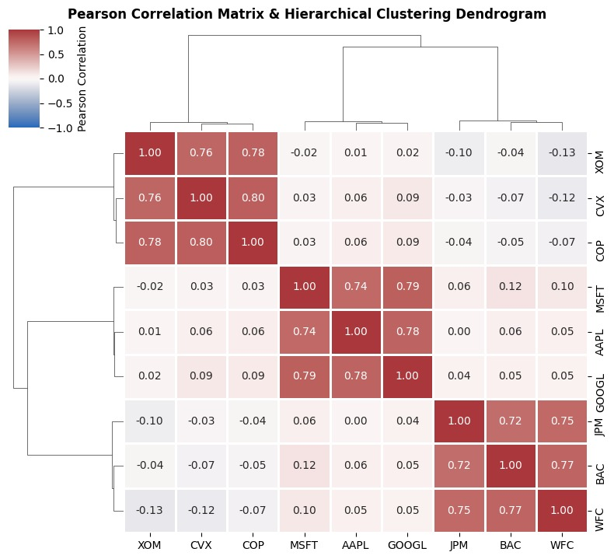
PRESENTER: IDAN GILAD
04 · THE STRATEGY & THE DATASET
The strategy — and what one data point is
Statistical-arbitrage pairs trading relies on price spreads mean-reverting, though structural breaks pose the main risk. We use Pearson correlation and cointegration to select pairs, then the question (will an extreme spread revert?) will be dealt by the supervised learning model.
The unit of observation is an extreme event based on the specific z-score and horizon and our dataset is based on this event.
Pearson correlations with hierarchical clustering — energy, tech and banking stocks fall into their own clusters (9-ticker example).
5 / 13
Notes:
1:00 — Gilad, verbatim (his slide 7): the strategy in one paragraph, then the key definition — one extreme event, defined by the z-score and horizon, is one row in the dataset.

Slide 6
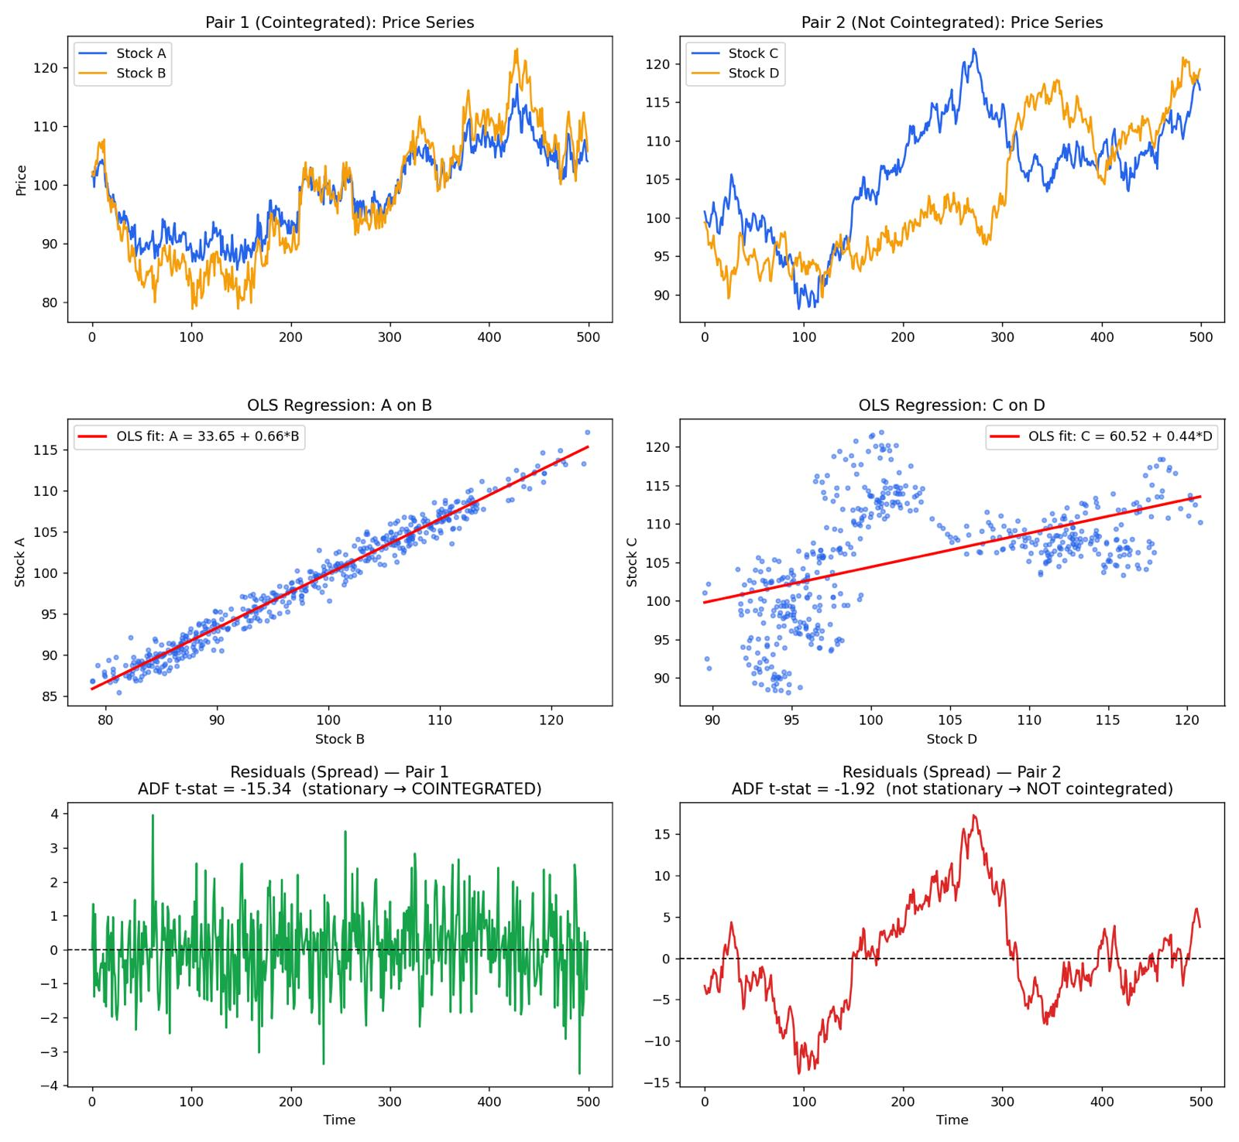
PRESENTER: IDAN GILAD
05 · COINTEGRATION TESTING
Cointegration: testing the gap
To run a statistically sound Pairs Trading strategy, we run the Augmented Dickey-Fuller (ADF) diagnostic tests.
We run a two-step Engle-Granger cointegration approach. By regressing the primary asset on its tracking peer, we model the stationary residuals. This allows us to trade high-probability mean-reversion trades.
The real test: Pair 1’s residual spread is stationary (ADF −15.34 → cointegrated); Pair 2 drifts (ADF −1.92 → rejected).
6 / 13
Notes:
1:00 — Gilad, verbatim (his slide 8): ADF diagnostics and the two-step Engle-Granger regression — regress one stock on its peer, test the residual. The charts show a stable gap vs a broken one.

Slide 7
PRESENTER: IDAN GILAD
06 · TIMING RULES
Timing rules: no peeking
Pair selection uses the formation window only.
Features at event day t use information up to and including t.
The label uses the future window (t, t + horizon]: did |z| fall below the exit band?
The train/test split later is by time, never random.
formation window
(t, t + horizon]
day t
features stop at day t — the label lives only in the green zone.
split by time → train is always earlier than test.
7 / 13
Notes:
1:00 — Gilad, verbatim (his slide 9): the four no-look-ahead rules. The timeline shows why the model can never peek — nothing to the right of day t is available at prediction time.

Slide 8
PRESENTER: IDAN GILAD
07 · SOLUTION IMPLEMENTATION
A needle in a haystack
Correlation finds the look-alikes; cointegration (Engle-Granger + ADF) keeps only gaps that truly snap back.
19,110
pairs scanned per window
499
correlated — Pearson ≥ 0.6
31
cointegrated — p ≤ 0.05
The funnel repeats across 12 rolling windows → 4,988 signals studied.
e.g. AMZN / GOOGL · ADBE / MSFT · AXP / MSFT
200 US stocks · 11 sectors
Daily prices 2018–2026
Yahoo Finance
Python · pandas · scikit-learn
8 / 13
Notes:
1:00 — Say the correlation conclusion instead of showing the matrix: correlation finds the look-alikes, the Engle-Granger cointegration test keeps only gaps that statistically snap back. 19,110 → 31 per window; ×12 windows → 4,988 signals. || Gilad, verbatim: To run a statistically sound Pairs Trading strategy, we run the Augmented Dickey-Fuller (ADF) diagnostic tests. We run a two-step Engle-Granger cointegration approach: by regressing the primary asset on its tracking peer, we model the stationary residuals. This allows us to trade high-probability mean-reversion trades.

Slide 9
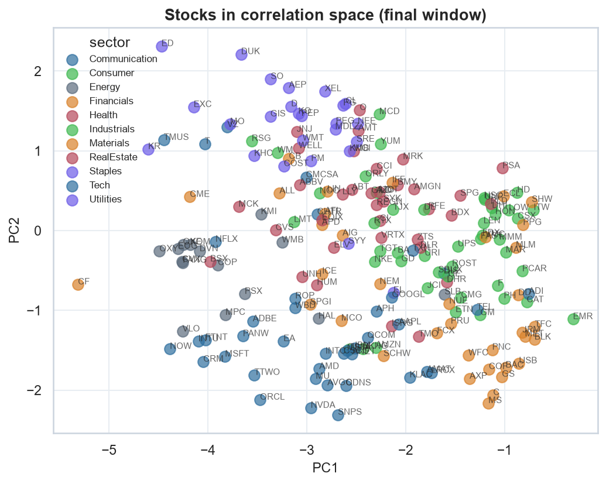
PRESENTER: NETANEL FARHI
08 · FEATURE ENGINEERING
Our secret ingredient: a market map
Each signal gets 29 measurements — mostly how the gap itself behaves. One family is ours alone:
1
Sectors settle into neighborhoods on the map.
2
A stock drifting away from its neighborhood is an early warning of a structural break — the pair may be failing.
3
That drift becomes a number the model reads (detach_max).
All 200 stocks placed by co-movement — colors are sectors. Rebuilt every month.
Gap behavior · core 11
Pair health
Market regime · the map
Market context
9 / 13
Notes:
1:00 — The most original piece of the project. A monthly map of the whole market: stocks that co-move sit together, sectors form neighborhoods. A stock drifting from its neighborhood warns the pair may be breaking — and the model reads that drift as a feature.

Slide 10
PRESENTER: NETANEL FARHI
09 · MODEL ALTERNATIVES
Why three models?
Same events, same features, same time-ordered split — three different inductive biases as a robustness check.
Logistic Regression
Random Forest
Gradient Boosting
MOST STABLE IN ROLLING TESTS
BEST TEST AUC · 0.665
TRAILED HERE · 0.656
Linear baseline — the most stable model under walk-forward validation.
Bagged trees capture feature interactions — best single-split ROC-AUC.
Sequential trees are data-hungry — trailed on our 4,988 events.
One task for all three: rank the events by P(revert).
10 / 13
Notes:
0:50 — Why compare: same data, three inductive biases — linear, bagged, boosted — as a robustness check on one ranking task. Linear won the honest rolling test, the forest won the single split, boosting is data-hungry. One line each; the icons carry it.

Slide 11
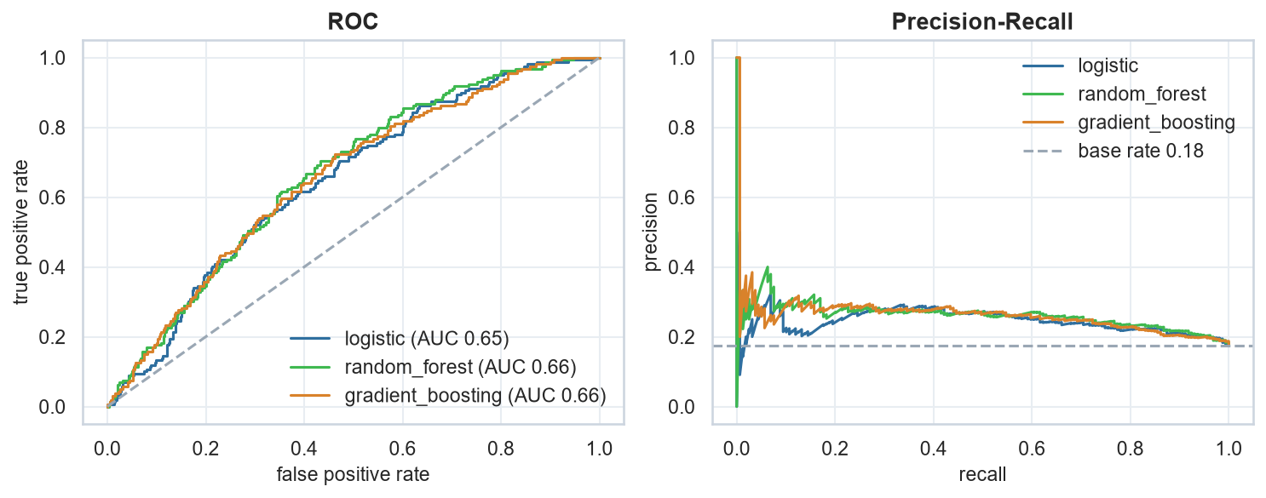
PRESENTER: NETANEL FARHI
10 · EVALUATION METRICS & RESULTS
What did the model learn?
To rank stronger opportunities above weaker ones — all numbers on data the model never saw.
ROC-AUC 0.665
PR-AUC 0.271
Precision 0.268 · Recall 0.453
walk-forward: 0.595 · 0.5 = coin flip
vs ≈0.19 base rate
flags 30% of events
ROC and precision-recall curves, held-out test · calibrated (Brier 0.145) · demo: win rate 17.5% → 26.8% on the model’s picks.
11 / 13
Notes:
1:00 — Point at the real curves. Left, ROC: the model ranks — 0.665 here, 0.595 under honest walk-forward. Right, precision-recall: 0.271 average precision against a ≈0.19 base rate — real lift where positives are rare. At our threshold: precision 0.268, recall 0.453, flagging only 30% of events; probabilities calibrated (Brier 0.145). In money terms that lift is the 17.5 → 26.8 win-rate jump — the small demo, not the headline.

Slide 12
PRESENTER: NETANEL FARHI
11 · KEY INSIGHTS & FUTURE IMPROVEMENTS
Three things to remember
1
The model ranks opportunities. ×1.5 precision over the base rate — in trading terms, 17.5% → 26.8% on unseen data.
2
Trust the harsh test. One lucky split said 0.665; strict rolling validation said 0.595. We report the honest number.
3
The gap holds the clues. The spread's own behavior predicted success — the broad market barely helped.
Before real money: trading costs · outside data (news sentiment, earnings) · calibrated probabilities
12 / 13
Notes:
0:45 — Slow down. Say each takeaway once, cleanly — these three lines are what the room should remember. The strip is the future-work section in one breath.

Slide 13
QUESTIONS WELCOME
Thank you.
Pairs trading, meta-labeled — the code and notebooks are open.
Netanel Farhi · Idan Gilad
github.com/Saul666/MidtermProjBIU
Notes:
0:15 — Thank the room, invite questions.

